Slide 1

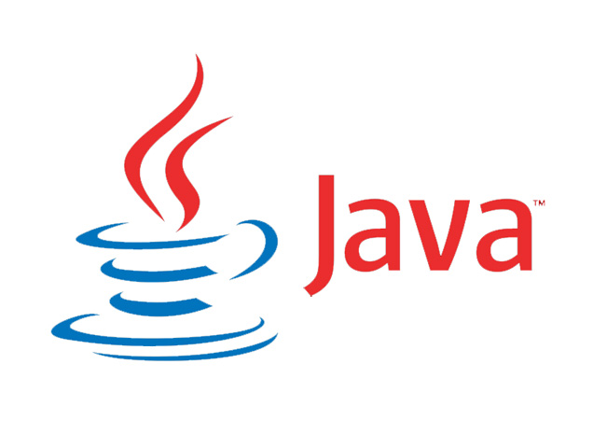
Plays Well With Others:
and

Slide 2

Notes:
To bridge the two programming languages

Slide 3
A Brief Introduction to Java
Programming language, libraries and runtime environment
Object-Oriented
Strongly Typed

